Slide 1
Data Types in Java

Slide 2
Introduction
The data types specify the different sizes and values that can be stored in the variable.
There are two types of data types in Java
Primitive Data types
Non-primitive data types

Slide 3
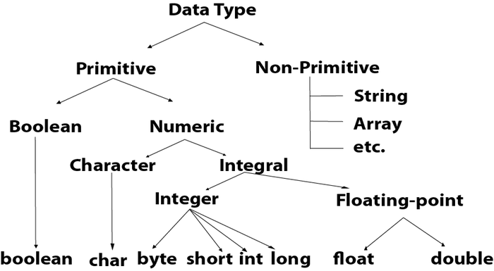
Java Primitive data Types
The primitive data types are the building block of data manipulation.
There are the most basic data types available in java Language.
They are 8 different types of primitive data types in Java.

Slide 4
Primitive data types
Data Types | Default Values | Default Size | Range | Default Value
Boolean | false | 1 bit | Stores true or false values | false
Char | \u0000 | 2 bytes | Stores a single character/letter or ASCII values | '\u0000'
Byte | 0 | 1 byte | -128 to 127 | 0
Short | 0 | 2 byte | -32,768 to 32,767 | 0
Int | 0 | 4 byte | 2,147,483,648 to 2,147,483,647 | 0
Long | 0l | 8 byte | -9,223,372,036,854,775,808 to 9,223,372,036,854,775,807 | 0L
Float | 0.0f | 4 byte | Sufficient for storing 6 to 7 decimal digits | 0.0f
Double | 0.0d | 8 byte | Sufficient for storing 15 decimal digits | 0.0d

Slide 5
Naming Convention
Java class, field, method, and variable names are written in CamelCase: Words are smashed together, and the first letter of each word is capitalized. No word separator, like the underscore _, is used.
thisIsAnExample
constants. Constants are in all-caps with words separated by underscores. Constants should also have the keyword final, and they are usually static:
Public static final double SPEED_OF_LIGHT = 299792458

Slide 6
Naming convention
Class and Interface : Class and interface names are generally noun or noun phrases and begin with a capital letter.
Example : class FootballGround()
Method names : Method names generally begin with a lowercase letter. A call on a procedure is a statement to do something, so a procedure name is generally a verb phrase that is a command to do something.
Public void kick(){ }
A function call yields a value, so a function name is generally a noun phrase that describes the value.

Slide 7
Variable naming
Variable names generally start with a lowercase letter.
It should give some hint to the read that what the variable is used for.
Thus, there is always some confusion that whether the name of variable should be long and more descriptive or whether the name of variable should be short.
Parameter names : when some function accept some parameters then we can short name because the length of the function can be at max 50-60 lines. Thus, they within the range without scrolling.

Slide 8
Variable Naming
Local variable names : A local variable that is declared in a method body should be placed as close to its first use as possible.
The scope of a local variable is usually short, and its meaning is often obvious either from comment on its declaration or from the short code in which it is used. Thus, it may be short.
Fields and class (i.e. static) variables : The declaration of fields and class variable may be far from their uses therefore the names of field and class variable should be longer and as mnemonic as possible, given the reader a good idea what the meaning are.

Slide 9
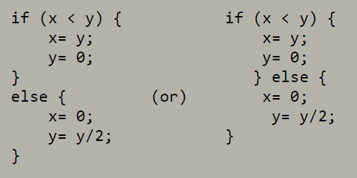
Indentation and braces { }
It is used to make the structure of a program clear.
Substatement of a statement or declaration should be indented.
It is suggested that first convention is better, and we will follow it
But in your life, you must experience both and then take an inform decision.
Always use braces for control flow structure.

Slide 10
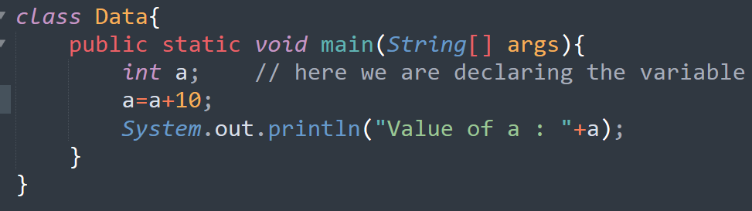
Declaration of a variable in Java
Error : Variable a might not be initialized

Slide 11
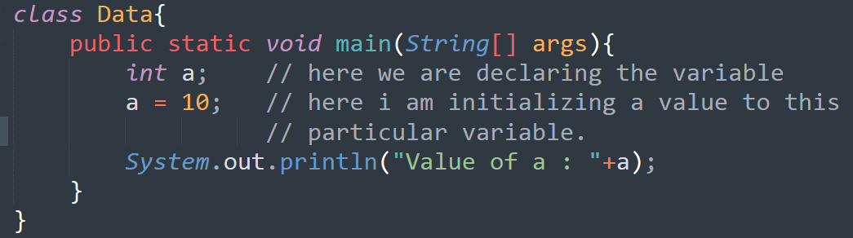
Initialization of a variable

Slide 12
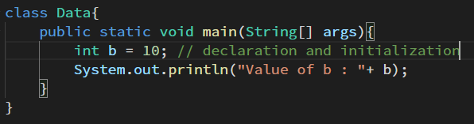
Declaration and initialization together

Slide 13
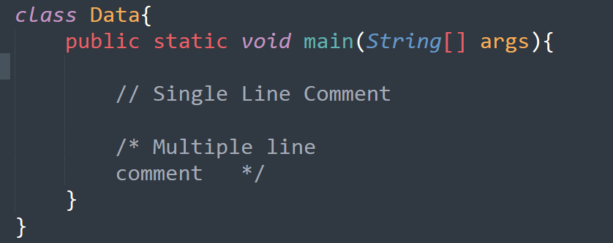
Comment in Java

Slide 14
Program
Try to assign a value into a variable whose value is out of range to this data type and check what will be the error.
Write a program to perform addition, subtraction, division and multiplication by using integer and float data types.
How to change from onto primitive data type to another primitive data type.

Slide 15
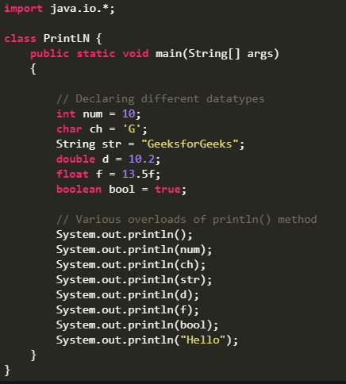
Output on Console
Whenever you must put some output onto the console screen like cout in case of C++ use the method System.out.println() or System.out.print().
Where the parameters of System.out.print() can be anything that the user wishes to print on the screen.

Slide 16
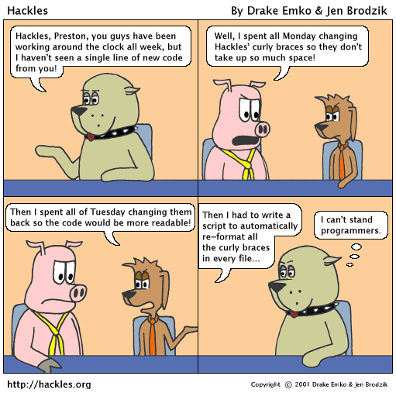
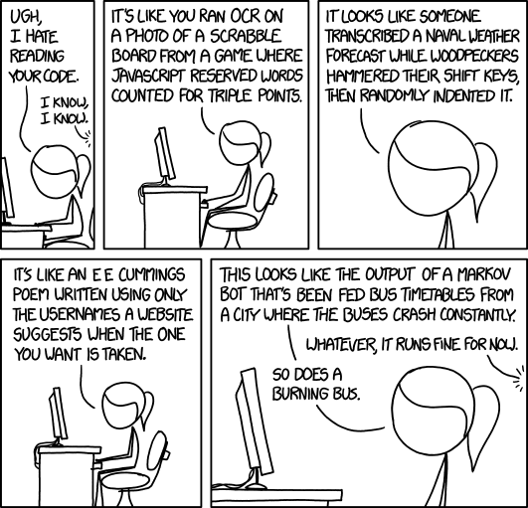
Programming Style

Slide 17
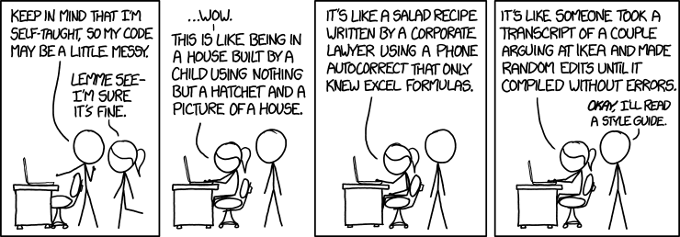

Slide 18
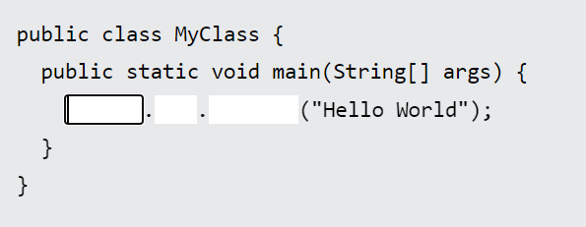
Exercise 1
Insert the missing part of the code below to output "Hello World".

Slide 19
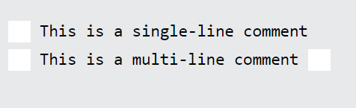
Exercise 2
Comments in Java are written with special characters. Insert the missing parts:

Slide 20

Exercise 3
Create a variable named carName and assign the value Volvo to it.

Slide 21

Exercise 4
Create a variable named maxSpeed and assign the value 120 to it.

Slide 22
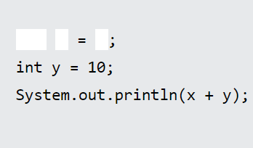
Exercise 5
Display the sum of 5 + 10, using two variables: x and y.

Slide 23
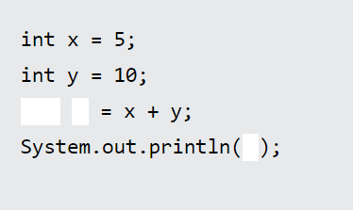
Exercise 6
Create a variable called z, assign x + y to it, and display the result.

Slide 24
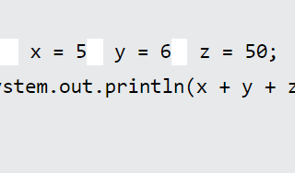
Exercise 7
Fill in the missing parts to create three variables of the same type, using a comma-separated list:

Slide 25
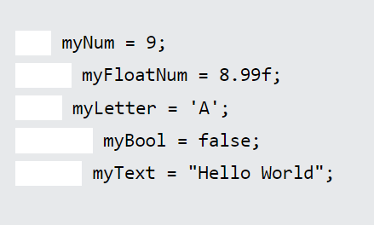
Exercise 8
Add the correct data type for the following variables:

Slide 26
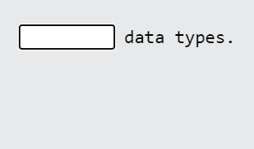
Exercise 9
byte, short, int, long, float, double, boolean and char are called:

